Slide 1



Strategic Approaches for Buying Accessible Technology
Corinne Weible | PEAT
Jay Wyant | State of Minnesota
Jeff Kline | State of Texas

Slide 2
Agenda
Integrating Accessibility into the Procurement Lifecycle
Texas: Contracting for Accessibility
Minnesota: Evaluating for Accessibility

Slide 3
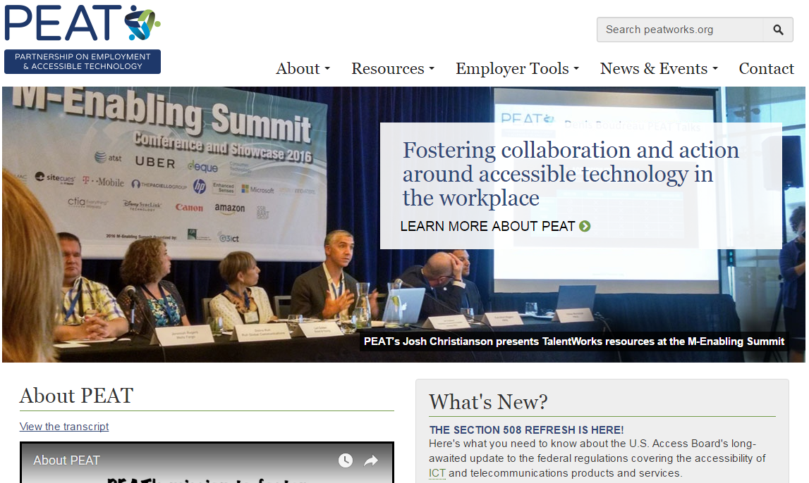
What is PEAT?
The Partnership on Employment & Accessible Technology
www.PEATworks.org
Notes:
a multi-faceted initiative to foster collaboration and action around accessible technology in the workplace. Guided by a consortium of policy and technology leaders, PEAT works to help employers, IT companies, and others to understand why it pays to build and buy accessible technology, and how to do so. PEAT is funded by the U.S. Department of Labor's Office of Disability Employment Policy (ODEP)(link is external)

Slide 4

Buy-IT!
Procuring Accessible Technology
www.PEATworks.org/Buy-IT

Slide 5
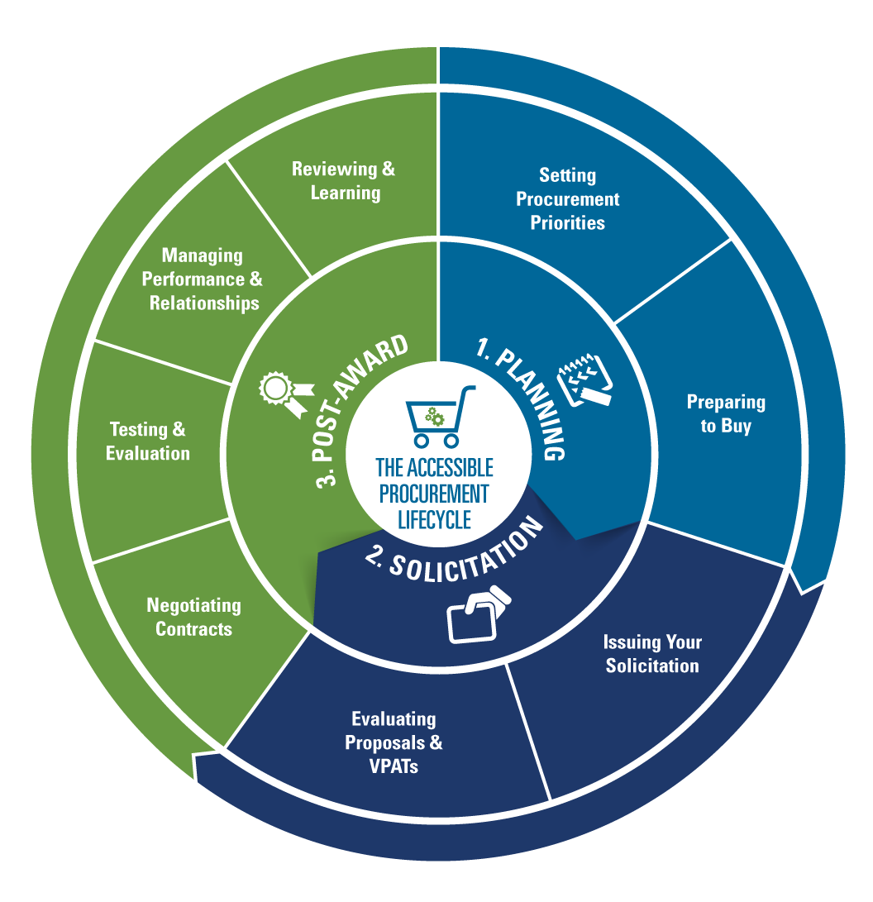
Lifecycle

Slide 6
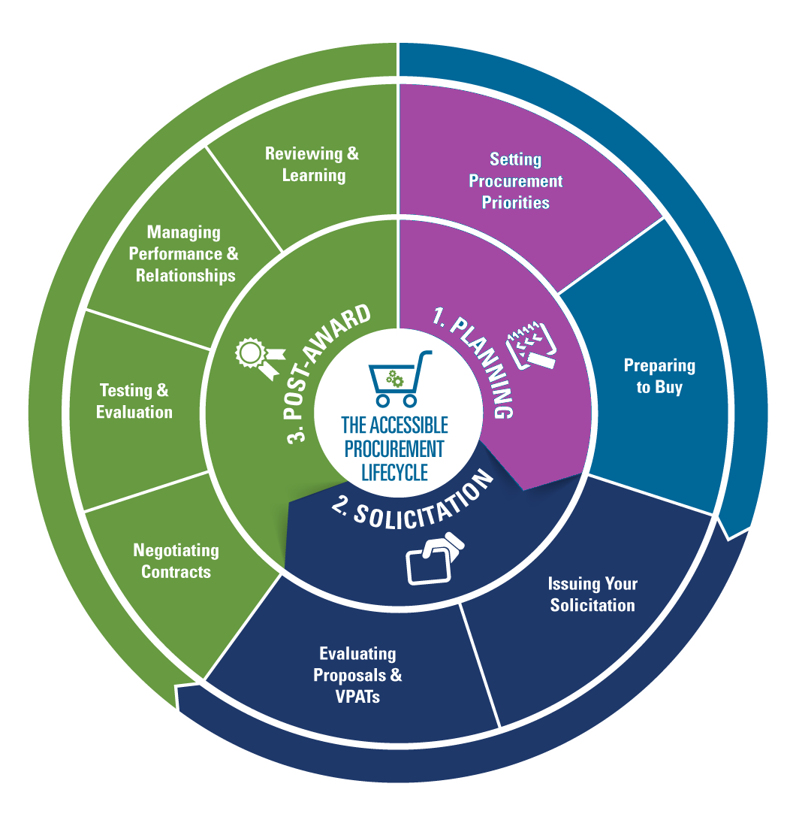
Setting Procurement Priorities
Plan Your Organization’s Procurement Strategy
1. Define Your Target Users – and design for extremes
2. Determine Your Technical Standards
3. Define Your Purchasing Needs
Conduct a comprehensive review of your company’s business requirements and overall purchasing needs, particularly where you can consolidate efforts
4. Assemble and Educate Your Purchasing Team from Across the Organization
Resources for getting started:
Policy Driven Adoption for Accessibility
GSA Technology Accessibility Playbook
G3ICT Guide to Adopting an Accessibility Procurement Policy

Slide 7
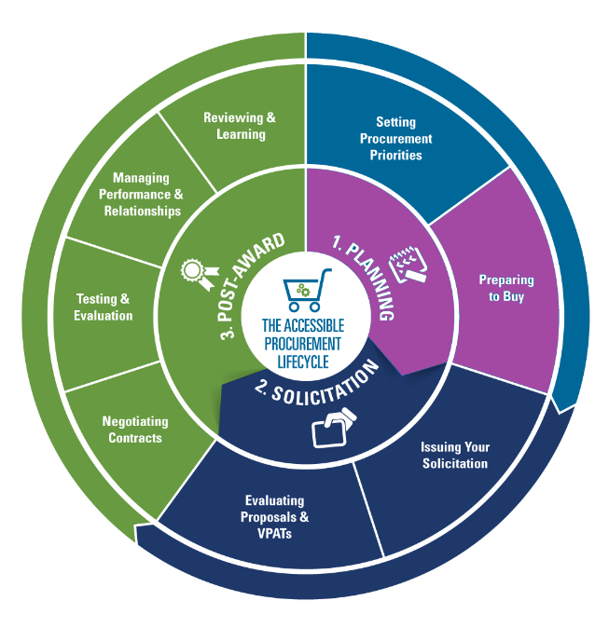
Preparing to Buy: Research
Researching Commercial Off-the-Shelf Vendors (COTS)
Ask to see VPATs, and for examples of other relevant products they've developed.
Know who are you talking with. (product / service manufacturer? value-added re-seller (VAR)? Other?
COTS Resources:
The Vendor Accessibility Resource Center
The Global Accessibility Reporting Initiative (GARI) for mobile devices
FCC's Accessibility Clearinghouse
Research for COTS and non COTS (Development Services)
Look for the following:
A formal Accessibility or Usability Statement on their website
Is THEIR website accessible?
Staff background and skills in accessibility training/expertise

Slide 8
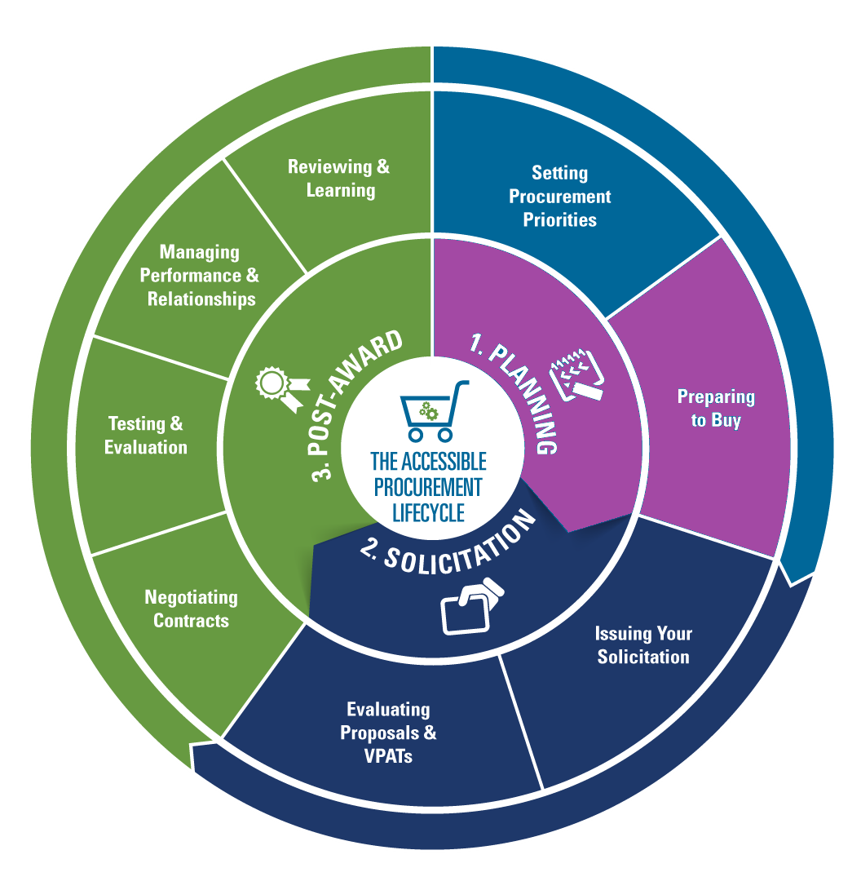
Preparing to Buy: The RFP
Issue Request for Proposals (RFP) The RFP and Sources Sought (used by government agencies) collect written information about the capabilities of various suppliers.
Benefits to the RFP
Discover new companies that you had not previously researched.
Helps you further define your requirements. For instance, you may lay out some initial requirements that the vendor builds upon with requirements you hadn’t considered. You can then include these in your formal solicitation.
Tips
Outline your accessibility requirements in your RFP
Ask specific questions about their experience developing, testing, and implementing accessible products.
When writing your RFP, BuyAccessible.gov’s QuickTips tool can help you get specific

Slide 9
Preparing to Buy: Meeting With Vendors
What to ask for:
Their experience with the technical standards you need
What types of similar products/services they have provided in the past
Names of their references/clients
Copies of sample solicitations they have responded to in the past
Demo of their product’s accessibility features and testing process documentation
Quick tips
Host an industry day event at your facility, engage in conference calls, or tour vendor facilities
The Federal Acquisition Regulations (FAR) encourage the exchange of information between potential offerors and the government after issuing an RFI.

Slide 10
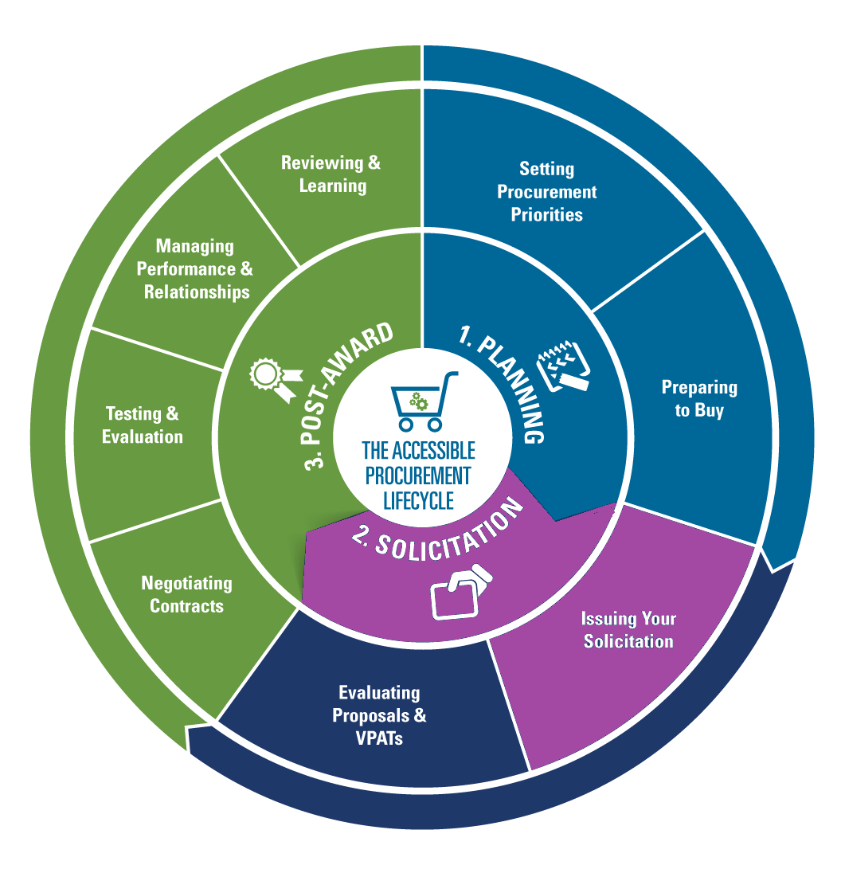
Writing the Solicitation
Weave accessibility requirements in prominent sections such as “Background” and “Scope/Approach”
Make accessibility a dedicated sub-section within the “Requirements” section. Sample questions:
Is your product/service fully compliant with WCAG 2.0 AA functional performance criteria, for both administrators and end users? How was this determination made?
Describe your accessibility conformance testing process.
Who will cover the costs of remediating any necessary fixes after purchase?
If your product is not fully accessible, do you have a roadmap to make your product fully compliant?
Maintenance Renewals: For an RFP for a maintenance renewal, include a requirement for an accessibility review of the product.
Include all of the people involved in the purchase, implementation, and use of the product you are buying in the solicitation process.

Slide 11
Writing the Solicitation, continued
Find actionable procurement language for the solicitations and performance reviews in the Buy ICT for All Portal
GSA’s BuyAccessible Wizard can help define requirements for your deliverables and provides solicitation language and recommended evaluation criteria. GSA also provides the excellent guide How to Request Accessibility Information from Vendors and Contractors.
Ensure that the evaluation criteria outlined in your solicitation includes accessibility requirements, and be transparent about your criteria and scoring methodology.
Consider a multi-stage evaluation and scoring process that includes demonstrations
PEAT provides sample Model Solicitation Language you can use in setting this criteria.

Slide 12
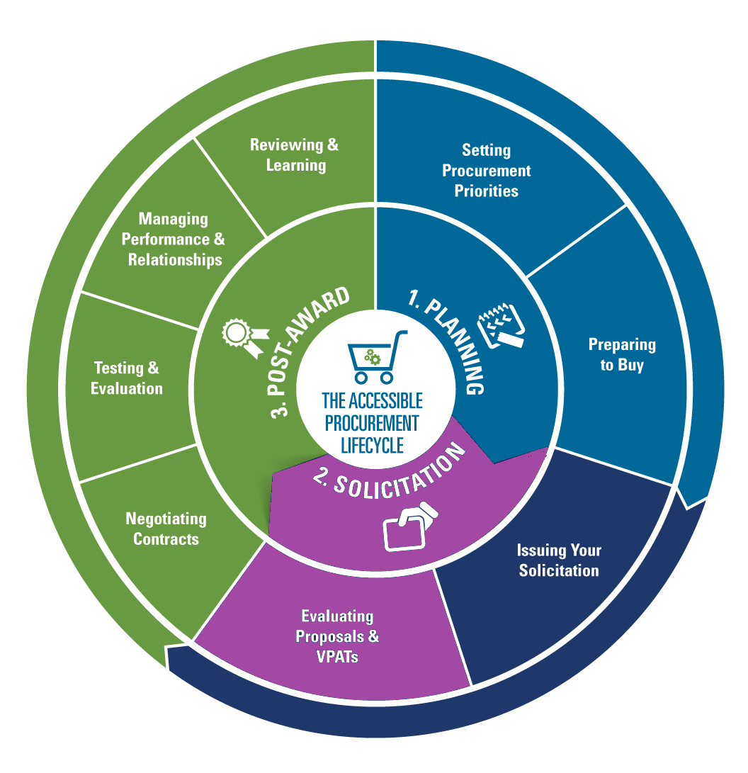
Evaluating Proposals & VPATs
COTS vs. Professional/Technical services
The Voluntary Product Accessibility Template 2.0 (VPAT)
Policy Driven Adoption for Accessibility (PDAA)
Accessibility-specific questions
References
Demonstrations
Related Resources:
GSA: How to Request Accessibility Information from Vendors and Contractors
ITIC VPAT® 2.0
Policy Driven Adoption for Accessibility (PDAA)

Slide 13
Accessibility Language for Texas DIR RFO’s
Scope Section 2.1: Electronic and Information Resources (EIR) Accessibility
Products, applications, and websites that will be used by Texas state employees or members of the public must comply with EIR accessibility technical standards as defined in 1 TAC 206, 1 TAC 213, and Web Content Accessibility Guidelines (WCAG) 2.0 level AA.
Accurate product Voluntary Product Accessibility Templates (VPATs) are required for Commercial Off-the-Shelf (COTS) offerings included in this contract.
If development services are included, vendors will be required to complete the Vendor Accessibility Services Development Information Request (VADSIR) or other documents as requested that describe vendor’s ability to produce accessible offerings.
The Successful Respondent shall provide a solution that is compliant with the above referenced standards, and provide satisfactory responses on the VADSIR or other documents.
Respondent shall complete:
Attachment C: ICT Accessibility Policy Assessment;
Attachment D: VPAT; and or
Attachment E: Vendor Accessibility Development Services Information Request.
Per Table 4: Response Package 1 Files, the Respondent shall include completed above-referenced attachments in Response Package 1.
Note: As an alternative to completing Attachment: D: VPAT, Respondents may provide external links to VPAT information. DIR requests Respondents provide electronic downloads of the relevant information from the external link, and that the electronic information be included in their Response Package 1. Hardcopies of VPATs is not required.

Slide 14
A Governance Model: Policy Driven Adoption for Accessibility (PDAA)
The integration of IT accessibility governance into organization policies in a way that enables them to drive themselves to improve accessibility adoption.
Makes IT accessibility difficult to ignore
Not prescriptive: tells what, not how
Governed through non-technical methods
Accelerates marketplace innovations
Can be applied to any private or public sector organization but its use in procurement can help drive vendors awareness and progress towards achieving more accessible offerings in the long term

Slide 15
PDAA Maturity Model
(Link to tool)
 | Core Criteria | Launch | Integrate | Optimize
1. | Policy Creation: Develop, implement, and maintain an ICT accessibility policy. | Have an ICT accessibility policy. | Have appropriate plans in place to implement and maintain the policy. | Establish metrics and track progress towards achieving compliance to the policy.
2. | Organization: Establish and maintain an organizational structure that enables and facilitates progress in ICT accessibility. | Develop an organization wide governance system. | Designate of one or more individuals responsible for implementation. | Implement reporting/decision mechanism and maintain records.
3. | Business Process: Integrate ICT accessibility criteria into key phases of development, procurement, acquisitions, and other relevant business processes. | Identify candidate processes for criteria integration. | Implement process changes. | Integrate fully into all key processes.
4. | Compliance Planning: Provide processes for addressing inaccessible ICT. | Create plans that include dates for compliance of inaccessible ICT. | Provide alternate means of access until the ICT is accessible; implement corrective actions process for handling accessibility technical issues and defects | Maintain records of identified inaccessible ICT, corrective action, and tracking.
5. | Training: Ensure the availability of relevant ICT accessibility skills within (or to) the organization. | Define skills/job descriptions. | Identify existing resources that match up and address gaps. | Manage progress in acquiring skills and allocating qualified resources.
6. | Communication: Make information regarding ICT accessibility policy, plans, and progress available to customers. | Make Launch level information available. | Make Integrate level information available. | Make Optimize level information available.

Slide 16
State of Texas VADSIR

Slide 17
Texas RFO IT Accessibility Initial Evaluation
Currently being used on select RFOs
Technology Based Training
Comprehensive Web Development
Working to integrate into all relevant RFOs
Scored for up to 15% of select procurements
Scoring components
VPATs (if applicable)
VASDIR (if applicable)
PDAA (required)
DIR-TSO-TMP-Sample
 | Vendor | Dev Services Rating | VPAT Rating | PDAA Score (0-100) | Accessibility Score (Up to 100%) | Overall Satisfactory Rating | Comments
1 | Vendor name | Satisfactory | 2 | 97 | 85.67% | High | Description of accessibility plans and integration into its Technical Solution appear comprehensive and well documented. VPAT submission: For the single VPAT provided, vendor should provide additional details on the exceptions listed. There also appear to be other COTS products included in the vendor response which may require VPATs and for which VPATs were not present. These include, but not limited to: XXX or its components thereof or any COTS or customized COTS products / services with user interfaces intended for Texas state employees or members of the public. Vendor should provide.
 | Acc. Value in bid | Calculation | Final Score |  |  | VPAT Scoring
 | 15% | .15 X 85.67 | 12.85 |  |  | 100pts | 3 - Credible, accessibility documentation for all or most products included in the bid response. Response shows strong understanding of accessibility by vendor
 |  |  |  |  |  | 60 pts | 2 - Questionable, incomplete or inaccurate accessibility documentation most likely not supported by testing
 |  |  |  |  |  | 15 pts | 1 - Accessibility documentation indicates very limited to no knowledge of accessibility
 |  |  |  |  |  | 0 pts | 0 - Accessibility documentation required but not provided
 |  |  |  |  |  | VADSIR Scoring
 |  |  |  |  |  | 0 | UNSAT - No completed VADSIR submitted but is applicable OR responses indicate insufficient knowledge of web accessibility to produce accessible websites / web applications
 |  |  |  |  |  | 50 | Low SAT - Responses indicate a deficiency of knowledge in key areas of website accessibility that significantly impacts the vendors ability to develop and deliver accessible websites / applications
 |  |  |  |  |  | 100 | SAT - Responses indicate an acceptable level of knowledge, skills, and processes to produce accessible websites / web applications
 |  |  |  |  |  | PDAA Scoring
 |  |  |  |  |  | 0-100 | As calculated on the PDAA Assessment form
 |  |  |  |  |  | Scoring Results | Overall Satisfactory Rating
 |  |  |  |  |  | 0 - 35% | Low
 |  |  |  |  |  | 36 - 70% | Medium
 |  |  |  |  |  | 71 - 100% | High

Slide 18
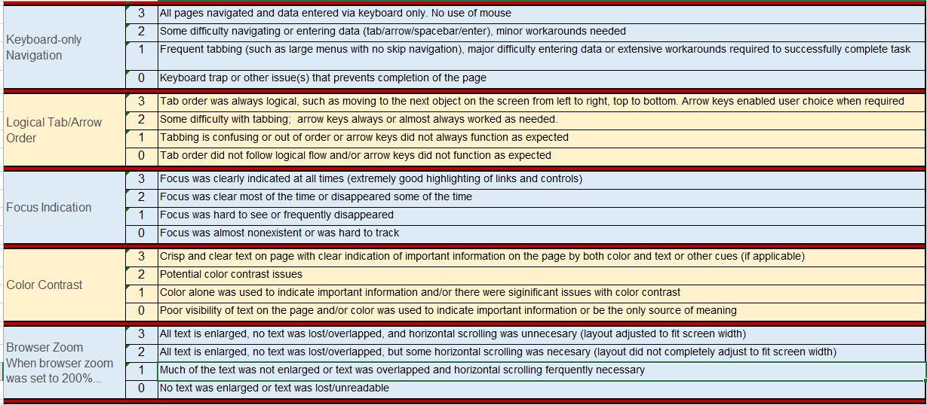
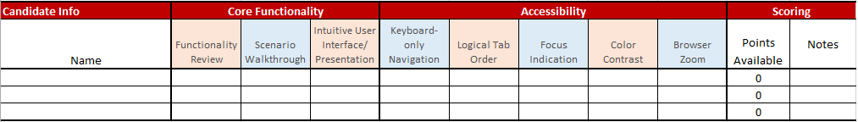
Demo Evaluation

Slide 19
Contract Inclusions for COTS / Development Services
Contract Inclusions | COTS | Development Services
The accessibility technical standard that you want the deliverable to meet such as WCAG 2.0 AA | Yes | Yes
Review / approval of accessibility plans / designs at designated checkpoints throughout the development cycle |  | Yes
Review / concurrence of accessibility platforms used for testing |  | Yes
Delivery of accessibility test results documentation and dates to be provided |  | Yes
Corrective actions criteria (prioritization of accessibility defects / issues, and resolution plans / dates) | Yes | Yes
Accessibility related remedies and warranties | Yes | Yes
Statement that you may request additional information as needed in support of the vendor deliverables | Yes | Yes
Pre delivery letter stating that accessibility documentation (VPATs, etc.) provided during solicitation activities was accurate, supported by and testing performed in accordance with generally accepted accessibility practices (including visual inspection and with an assistive technology. | Yes
Pre deliverable letter stating that accessibility documentation provided during solicitation activities was accurate, and that the deliverable(s) development and testing were performed in accordance with generally accepted accessibility practices (including visual inspection and with an assistive technology), and that the development test results and other documentation for the contracted deliverable(s) supplied to your organization are accurate, and that the deliverable complies with the specified accessibility standards (or cites exceptions where it doesn’t with a corrective actions plan) |  | Yes

Slide 20
Thank You!
Presentation link: PEATworks.org/CSUN18
Corinne Weible | PEAT |cweible@peatworks.org
Jay Wyant | State of Minnesota | jay.wyant@state.mn.us
Jeff Kline | State of Texas | jeff.kline@dir.texas.gov

